Slide 1
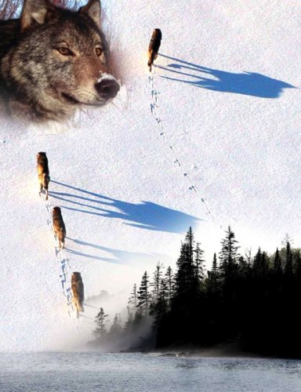
The Wolves and Moose
of Isle Royale

Slide 2
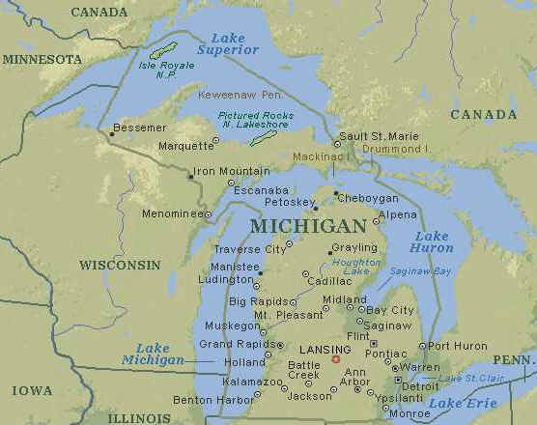
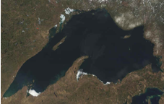
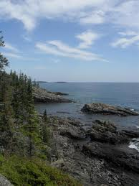
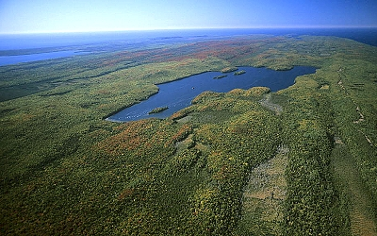
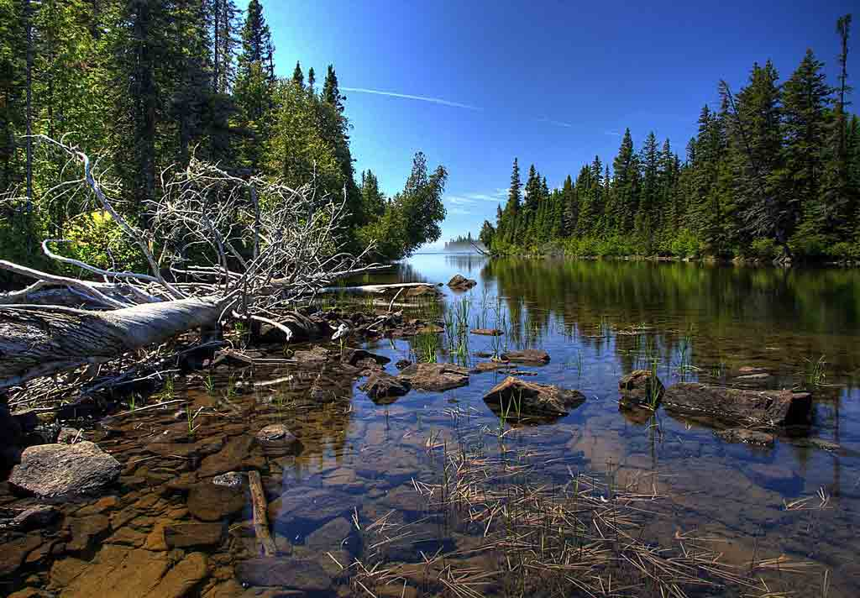
Isle Royale
National Park

Slide 3
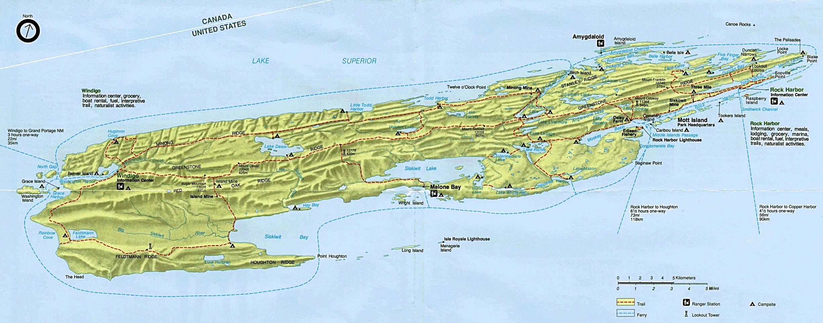
The Wolves and Moose of Isle Royale
Isle Royale is located in the northwest portion of Lake Superior. It is 45 miles long and 9 miles wide.
Isle Royale is home to a population of wolves and moose. These wolves are the sole predator of the moose, and moose represent ~90% of the wolves’ diet.
The wolves, the moose, and their interactions have been studied continuously and intensively since 1958. This is the longest study of any predator-prey system in the world…

Slide 4
Why so special?
If Isle Royale were smaller than it is, it would be too small to support a wolf population.
If Isle Royale were larger than it is, it would be too large to effectively study the moose population.
If Isle Royale were further from the mainland than it is, wolves and moose may never have made it to Isle Royale.
If Isle Royale were closer to the mainland than it is, other species which are not on Isle Royale, such as coyotes, deer, and bear, might have complicated the species interactions.

Slide 5
Moose first came to Isle Royale in about the year 1900. They probably swam to Isle Royale. In a typical year, Isle Royale has ~1000 moose.
During the summer moose eat enormous amounts of food (~40 lbs per day) and will increase its body weight by ~25%. All of this weight is lost each winter.
Although the maximum life span of a moose is ~17 years, most moose die before reaching 9 years of age. The difficulties of being a moose are numerous... avoid being killed by wolves, endure loads of blood-sucking and life-draining ticks, feed in the summer heat that moose find sweltering, all while trying to build up enough fat to make it through the brutal winters.

Slide 6
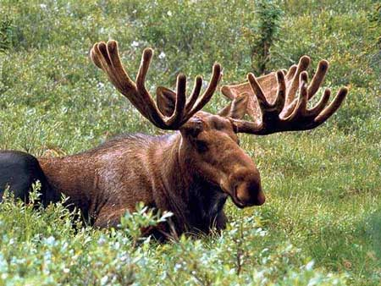
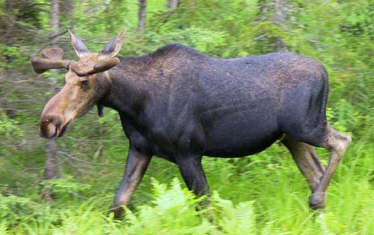
Other than the strong bond between mother and calf, moose are solitary animals.

Slide 7
Wolves first came to Isle Royale in about the year 1950. They arrived by walking on an ice bridge from Canada. In a typical year, Isle Royale has ~24 wolves living in three packs.
While a wolf is able to live for 12 years, most die before their 4th birthday. The most common causes of death are starvation and being killed by other wolves. When wolves kill wolves they are - ultimately - fighting over food.

Slide 8
Wolves hunt in packs and are very territorial. When a wolf is killed by another wolf, it is because of a territory dispute. The territory size relates to the amount of food available to the pack.

Slide 9
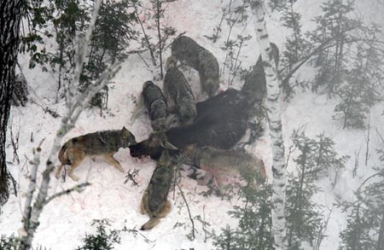

Slide 10
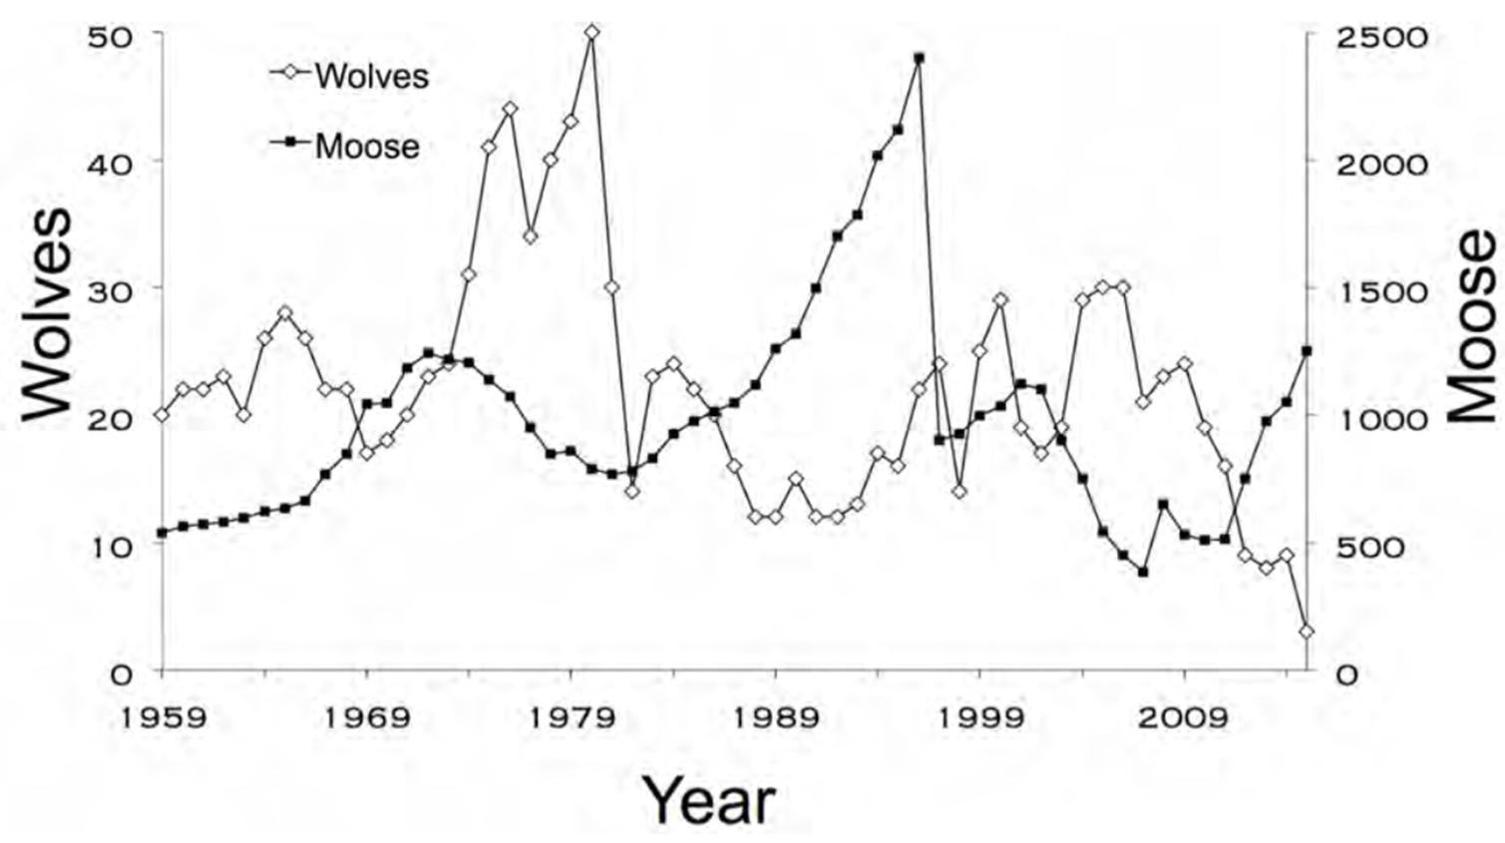
Classic predator-prey interaction…
Click graph for animation
…or is it?

Slide 11
Other Factors Affecting Moose and Wolf Populations

Slide 12
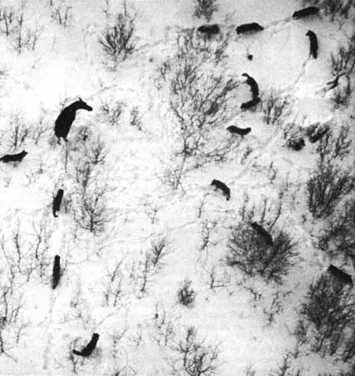
Once snow depth exceeds 30 cm (the average belly height of moose calves) predation rates go up significantly. Yearling moose also are slowed down by deep snow.

Slide 13
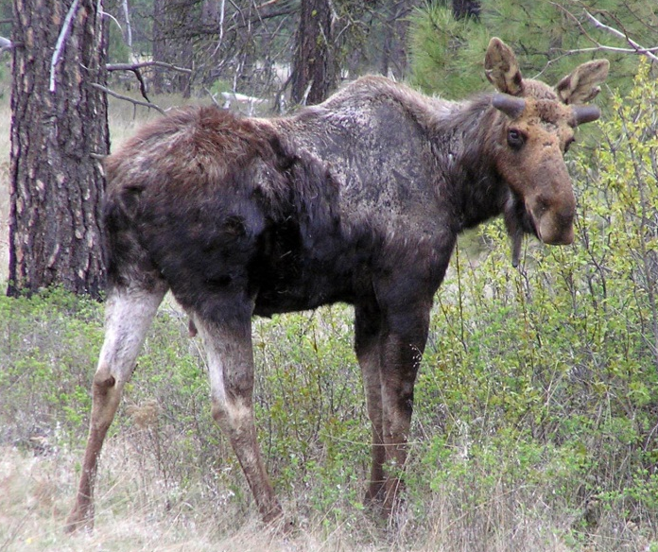
Moose Ticks - each the size of your fingernail when fully engorged - have a profound effect on the health of the moose population. In normal situations, moose are almost starved by the end of the long, cold winters. Ticks weaken moose even more and by the end of the winter many starve to death or are easy targets for wolf predation.

Slide 14
During winter, balsam fir comprises 30-60% of a moose’s diet. Balsam fir is not very nutritious, but is it relatively abundant - so moose eat it. Since balsam fir is such an important part of a moose’s winter diet, the moose and forest are connected importantly through balsam fir...

