Slide 1
 | ®
Forging new generations of engineers

Slide 2
Reverse Engineering
and
Functional Analysis

Slide 3
Reverse Engineering
Reverse engineering (RE) is the process of taking something apart and analyzing its workings in detail, usually with the intention of understanding its function.
Engineers use this information to prepare documentation, generate electronic data, or construct a new or improved device or program.

Slide 4
Why Perform RE?
Improve the design of a flawed product.
Improve the design of a part to maximize manufacturing techniques and appropriate materials.
Redesign a part to increase a company’s profit margin.
Discover how a competitor’s product functions.

Slide 5
Why Perform RE?
Create documentation and part files that were non-existent.
Continue the development of a well-designed object.
Reduce negative environmental impacts.

Slide 6
Stages of RE
Visual Analysis
Functional Analysis
Structural Analysis

Slide 7
Functional Analysis
After a product has been selected, a non-destructive Functional Analysis is performed.
First, the product’s purpose is identified. Next, observations are made to determine how the product functions. These observations are recorded in detail. Lastly, the system’s inputs and outputs are listed.

Slide 8
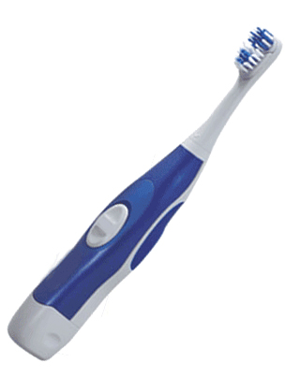
Functional Analysis Example
The purpose of a toothbrush is to clean teeth and gums to prevent tooth and gum decay. Water and a cleansing paste are also used in conjunction with the brush.

Slide 9
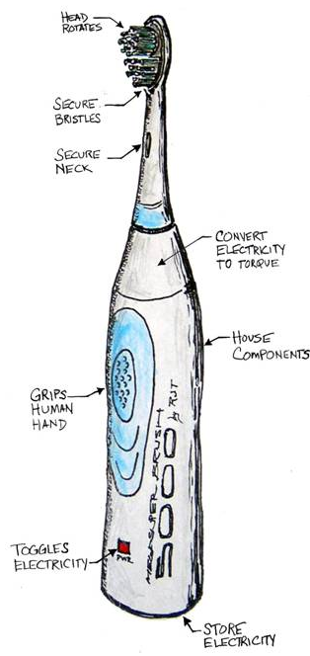
Functional Analysis Example
The engineer makes an annotated sketch of the product and labels all of the visible components.
This information is used to write up a detailed analysis of the object’s sequential operation, or function.

Slide 10
Black Box Systems Model
A black box systems model is used to identify what goes into and out of the product in order to make it work as a system.
Inputs
Output
Product Function

Slide 11
Black Box Systems Model
The “black box” is used to represent the product’s internal components or processes, which are deemed unknown at this point.
Inputs
Output
Product Function

Slide 12
Functional Analysis Example
Sound
Heat
Waste
Clean teeth and gums
Hand motion
Toothpaste
Water
Energy
Inputs
Output
Product Function

